Slide 1
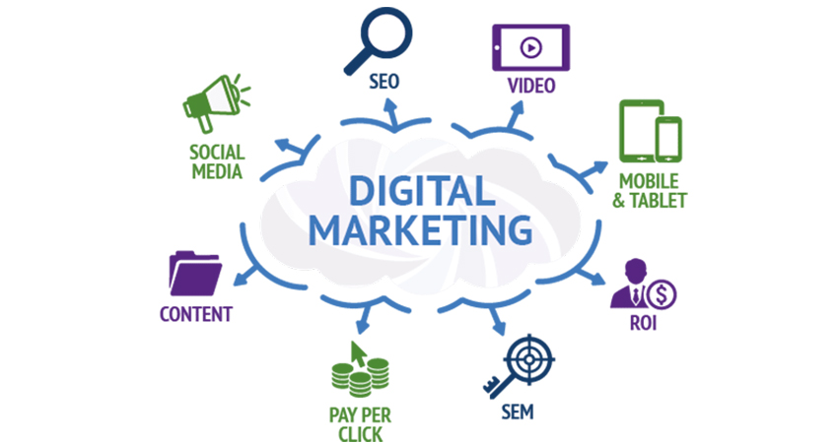
Project 4: Run a SEO AUDIT
Laavanya Ganesh
THE ONLY FASHION THAT NEVER DIES

Slide 2
DMND Program
MARKETING OBJECTIVE: To increase the visibility of the DMND website in the search engine by 50% by March 2019 through 3 on-site and off-site performance tests
PRIMARY KPI: Number of people downloading the free eBook during the period.

Slide 3

Target Persona
Background
Age: 26 years old
Education: Bachelor’s Degree
Location: California, USA
Job Title: Analyst
Email: Daniel2093@gmail.com
Annual Income: 500000 USD
Needs
Better Work/Life Balance
Growth in a Big Company
Love what I do
Become more technical
Balance between career expectations and family
Being my own boss
Educational content that provides: Quality and environmental friendliness
Target Persona
Daniel Krum
Free Time Activities
Watching movies and TV with friends
Sailing
Reading marketing/digital marketing articles
Biking Traveling
Cooking and baking
Reading, Writing
Spending time outside - swimming, kayaking, snow shoeing
Enjoy live music and travel
Hang out with kids and play basketball
Goals
To be a great marketer
Build something impactful
Want to be the owner of my life
Growth in current role
Would like to be an entrepreneur managing digital marketing for businesses, and have a successful drop shipping business.
Want to be working remotely as a Social Media Marketer/Manager or want to be running my own Affiliate Marketing brand/business
Professionally, want to be working remotely as a Social Media Marketer/Manager or want to be running my own Affiliate Marketing brand/business
To have a remote job as a digital marketer by March 2019. To travel to all 50 states by December 2019
More passion focused
Barriers
Travel time to work
From a small town, lack of marketing opportunity here outside of being a freelancer
Lack of time
Obtaining a degree that doesn't help get the jobs
Work Over 40 Hours Weekly
Price of Nanodegree programs
Mental barriers, hesitation
Lacking skills to do the job

Slide 4
ON-SITE SEO KEYWORD AUDIT

Slide 5
KEYWORDS
Using Moz Keyword Explorer tool, the following Keywords might be targeted to drive users to this page based on the priority score only
Head Keywords | Tail Keywords
social | why digital marketing
social media | what is digital marketing
digital marketing | udacity nanodegree
social media marketing | udacity digital marketing nanodegree
online marketing | digital marketing course

Slide 6
POTENTIAL KEYWORDS
Head Keyword with highest potential
Social
Organic CTR – 100%
Priority score - 94
Difficulty - 65
Monthly Volume – 70.8k to 118k
Tail Keyword with highest potential
What is digital marketing
Organic CTR – 58%
Priority score - 79
Difficulty - 57
Monthly volume – 4.3k to 6.5k

Slide 7
BLOGPOSTS
This week’s top stories about search engine optimization
Digital Marketing explained in less than 140 Characters
The next big thing in social media advertising
I chose the keywords for three blog topics as they best represent a superb method of showing a wide range of people. I selected these topics using Hubspot’s Blog Idea generator for a variety of reasons.Firstly, SEO is vital to the ability to be seen online. Secondly, SEM is equally as important if not more important than search engine optimization. And three, I want to show how these two factors can incorporate a good plan to become an excellent digital marketer through earning a Nanodegree in this field from Udacity.

Slide 8
URL: dmnd.udacity.com
Current
Title Tag | Udacity Digital Marketing Nanodegree Program Website
Meta- Description | Blank
Alt-Tag | Blank
Revision
Title Tag | Digital Marketing Nanodegree Program |Udacity
Meta- Description | Gain real-world experience running live campaigns as you learn from top experts in the field. Launch your career with a 360-degree understanding of digital marketing
Alt-Tag | 1) Udacity logo 2) DMND logo 3) Course content partners 4) Image with curriculum displayed 5)Tech giants collaborators
Technical Audit – Meta Data

Slide 9
BACKLINK | DOMAIN AUTHORITY (DA)
medium.com/‎@christineslfok/dear-fellow-career-changers-7b53323d5b0a‎ | 94
medium.com/‎@bglutz1/how-your-thirties-can-help-you-change-careers-digital-marketing-2498529c814a‎ | 94
medium.com/‎@bpgiri78/whats-next-a-marketing-professional-s-dilemma-db0982bbc579‎ | 94
Technical Audit – BACKLINK

Slide 10
Site Name | Marketing Land
Site URL | www.marketignland.com
Organic Search Traffic | 63.1K
Site Name | Facebook
Site URL | www.facebook.com
Organic Search Traffic | 633M
Site Name | Smart insights
Site URL | www.smartinsights.com
Organic Search Traffic | 75.9K
Technical Audit – LINK BUILDING

Slide 11
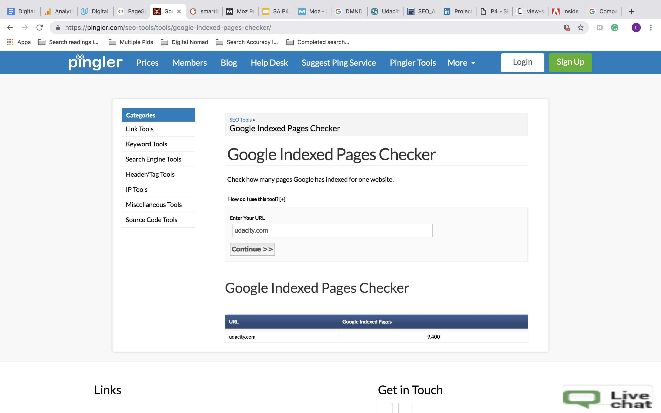
PAGE INDEX
Pages Indexed For Udacity’s Main Webpage: 9,400
The above result is for udacity.com
dmnd.udacity.com has zero pages indexed by Google
It elucidates the potential outreach to potential customers.
The greater outreach a page has, the more people who will see
links to the webpage.
More pages indexed in search engine database, the visibility of the
website is increased in SERP

Slide 12
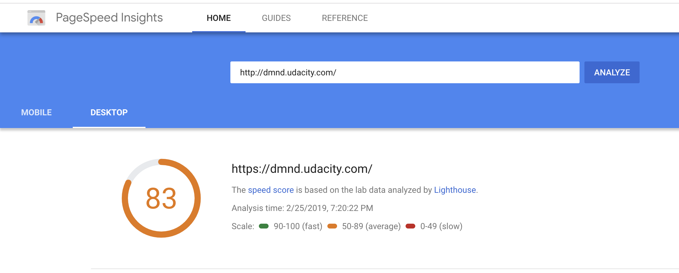
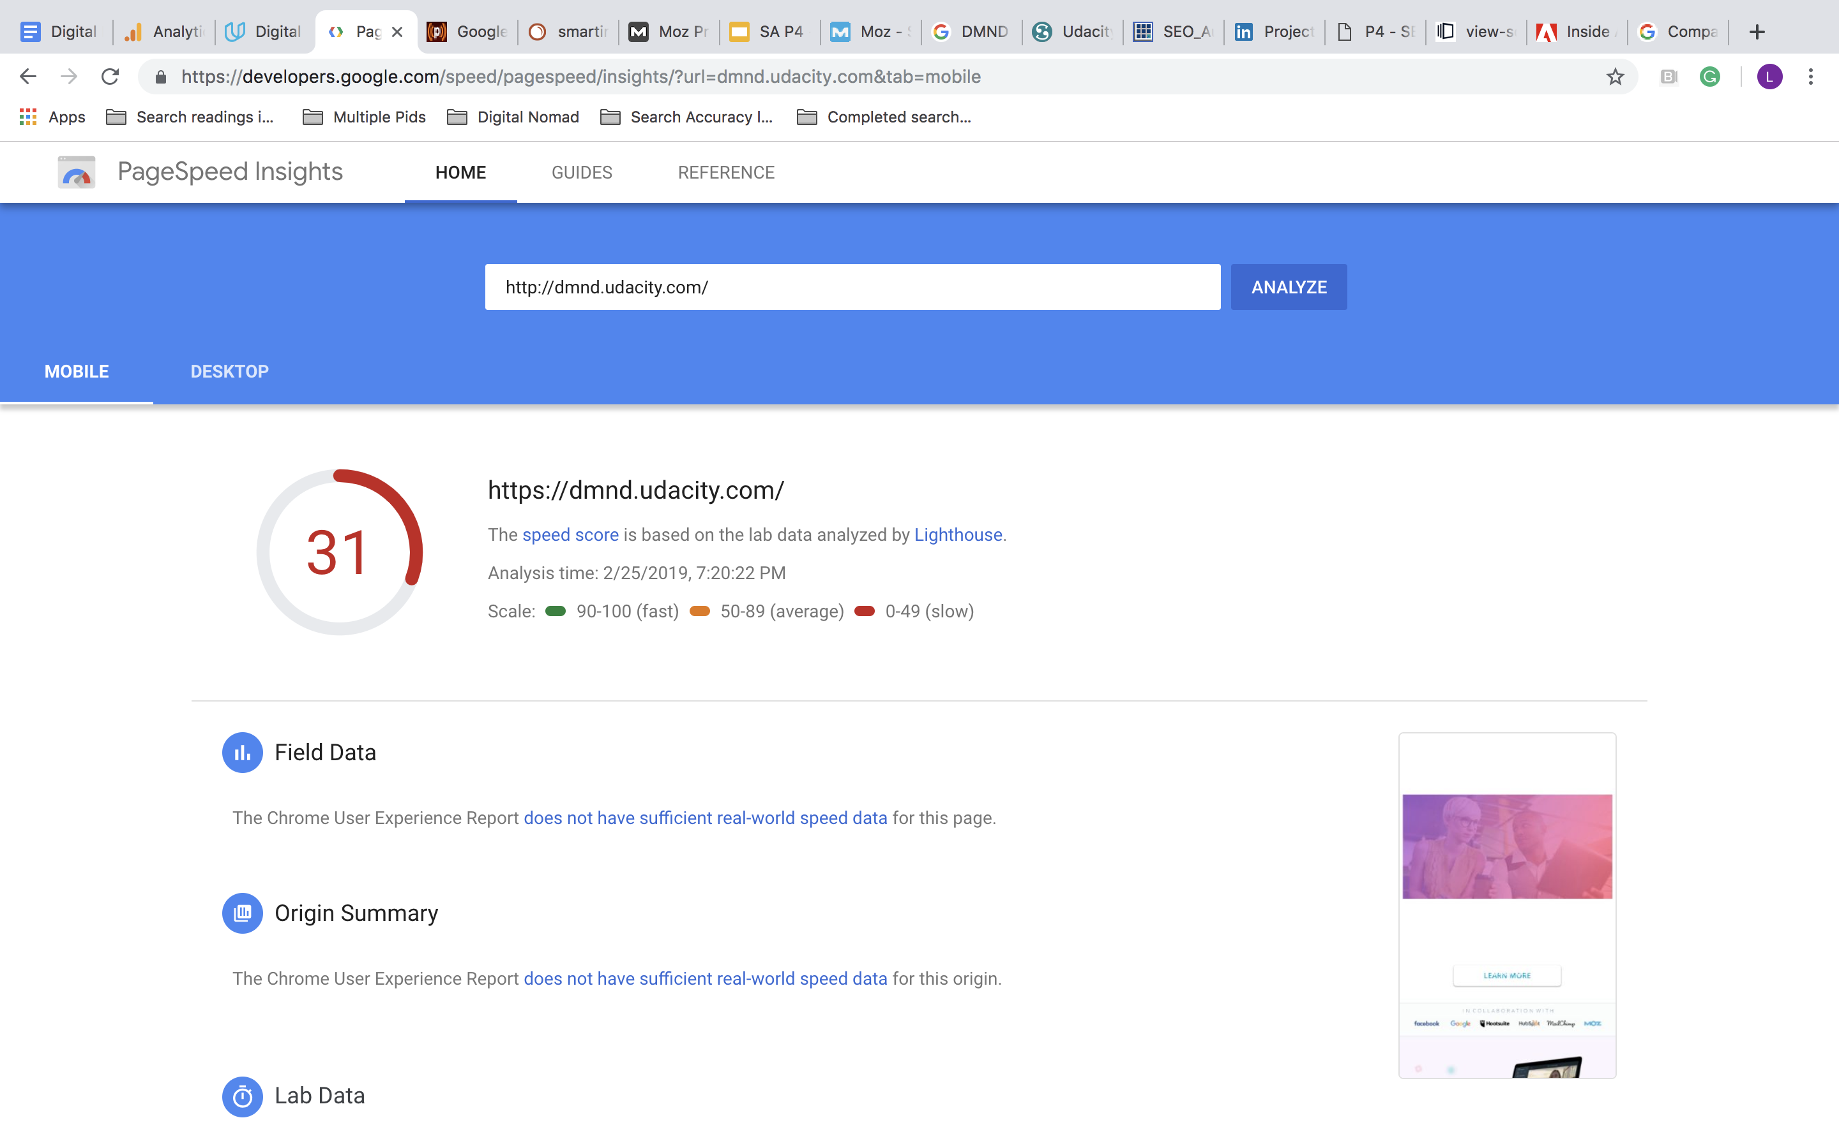
DESKTOP
PAGE SPEED
It elucidates a user must be able to load a page without
having to wait several seconds to view the content
on the page. Slow speed leads to higher bounce rate
MOBILE

Slide 13
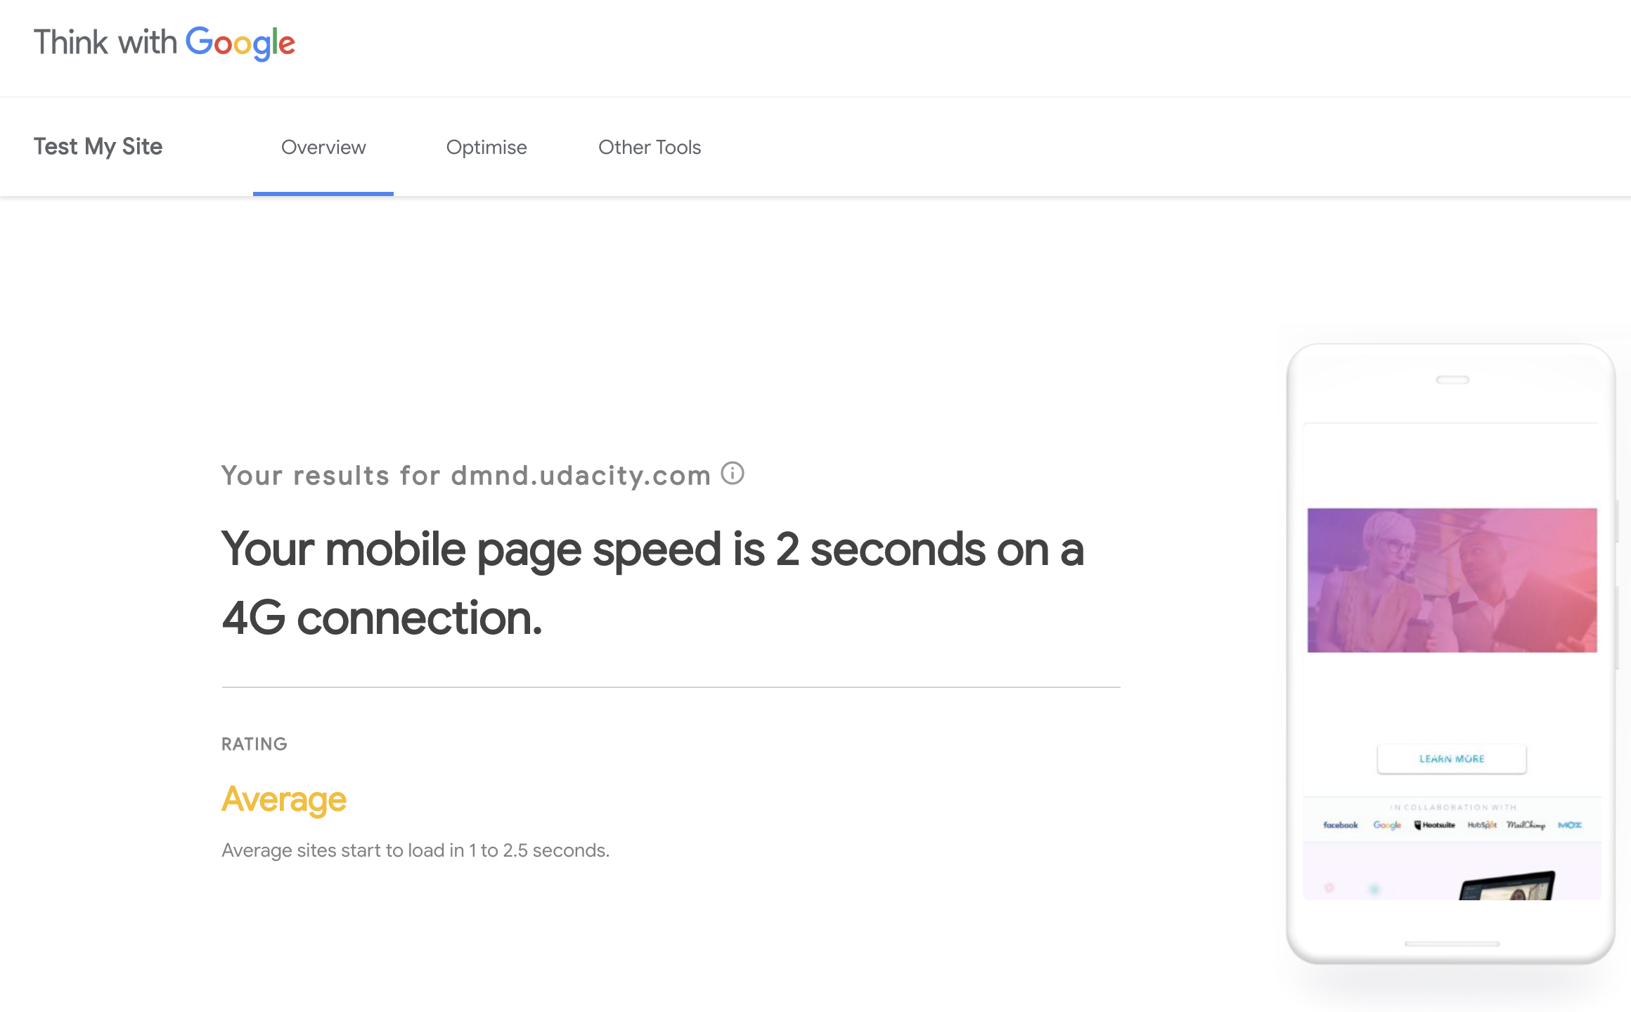
MOBILE FRIENDLY EVALUATION
Mobile users are more than desktop
users these days.
The webpage must be mobile optimized
because users should not be forced to
view a page designated for desktop and
laptop computers on such a tiny screen
like a phone or tablet even.

Slide 14

RECOMMENDATIONS
Meta-Description tag and alt-tag are blank currently. This will result in the poor website performance in SEO. I would recommend to add high quality content to meta description summarizing the key information per page. I would also recommend the addition of descriptive captions for the images in the alt-tag.
Pingler test results shows that DMND pages are not indexed by the Google. Indexing these pages will help in increased page rank.
Page speed on the mobile is very poor, this can be resolved by using the optimization suggestions by Google. Optimize listed Images from PageSpeed by Reducing their size.

